Slide 1
Open Data Market Segmentation
Strategy for community outreach, communication and self-assessment
Jason Hare: Open Data Consultant

Slide 2
Comparison of Recovery
Raleigh’s Rank and Recovery
Durham’s Rank and Recovery
Raleigh is in the First Quintile, Durham is in the Middle
City/County Open Data Update 2

Slide 3
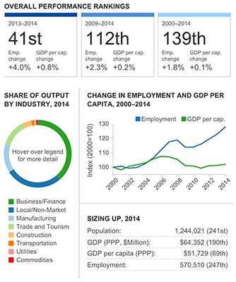
Raleigh 2014 Recovery data
Source Brookings Institute

Slide 4
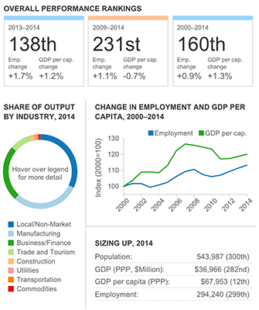
Durham 2014 Recovery data
Source Brookings Institute

Slide 5
Agenda
How is Durham Segmented?
How are Open Data Programs Segmented?
How do we Assess the Health of a Neighborhood, Segment or Cluster?
City/County Open Data Update 2

Slide 6
Agenda
How is Durham Segmented?
How are Open Data Programs Segmented?
How do we Assess the Health of a Neighborhood, Segment or Cluster?
City/County Open Data Update 2

Slide 7
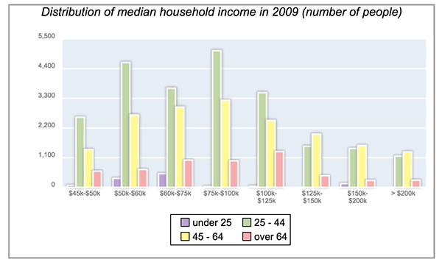
Segments by Income
City/County Open Data Update 2

Slide 8
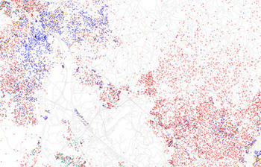
Segments by Diversity
City/County Open Data Update 2

Slide 9
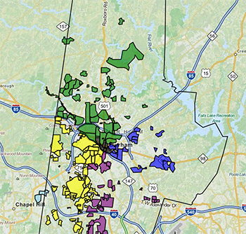
Segments by Neighborhood
City/County Open Data Update 2

Slide 10
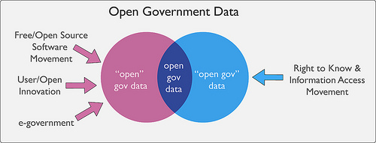
Types of Open Data Programs
City/County Open Data Update 2

Slide 11
Agenda
How is Durham Segmented?
How are Open Data Programs Segmented?
How do we Assess the Health of a Neighborhood, Segment or Cluster?
City/County Open Data Update 2

Slide 12
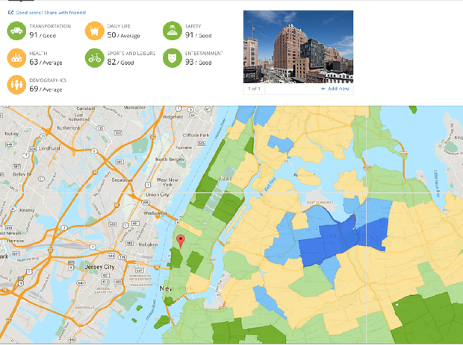
Assessing Segments/Clusters
City/County Open Data Update 2

Slide 13
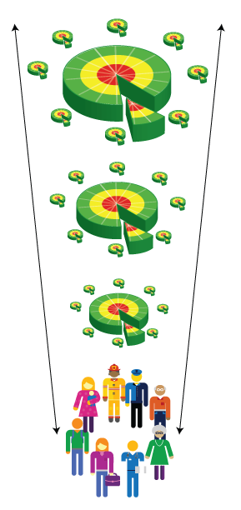
Assessing Segments/Clusters
Management of quality in local governments can result in sustainable economic prosperity and social development at local level including deployment of and interaction with national and regional policies in coherent and compatible way.
National
Regional
Local

Slide 14
ISO Assessments
18091 is built around a diagnostic system for local governments, which is composed of 4 quadrant with 39 measurable indicators:
Institutional Development for Good Government
Sustainable Economic Development
Inclusive Social Development
Sustainable Environmental Development.
City/County Open Data Update 2

Slide 15
ISO Assessments
18091 is built around a diagnostic system for local governments, which is composed of 4 quadrant with 39 measurable indicators:
Institutional Development for Good Government
Sustainable Economic Development
Inclusive Social Development
Sustainable Environmental Development.
City/County Open Data Update 2

Slide 16
Triangle Open Data Day
Overwhelming support of message
All Tweets are positive
Demonstrating some numbers just from one Tweet account- mine
City/County Open Data Update 2

Slide 17
Triangle Open Data Day
Overwhelming support of message
All Tweets are positive
Demonstrating some numbers just from one Tweet account- mine
City/County Open Data Update 2

Slide 18
Triangle Open Data Day
Overwhelming support of message
All Tweets are positive
Demonstrating some numbers just from one Tweet account- mine
City/County Open Data Update 2

Slide 19
Triangle Open Data Day
Overwhelming support of message
All Tweets are positive
Demonstrating some numbers just from one Tweet account- mine
City/County Open Data Update 2

Slide 20
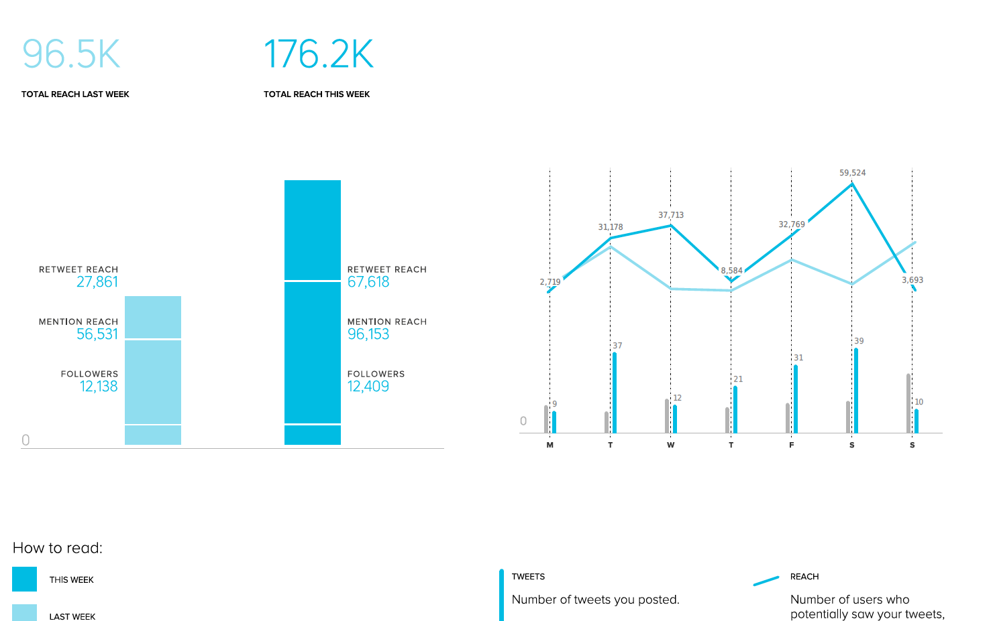
Measuring Impact
City/County Open Data Update 2

Slide 21
Open Data as a PoC
Aligns with County Goal 5: Accountable, Efficient and Visionary Government
Aligns with City Goal 4: Well-Managed City
City/County Open Data Update 2

Slide 22
Agnostic Measures/KPIs
County Goal 5: Accountable, Efficient and Visionary Government
Aligns with City Goal 4: Well-Managed City
City/County Open Data Update 2

Slide 23
Agnostic Measures/KPIs
County Goal 5: Accountable, Efficient and Visionary Government
Aligns with City Goal 4: Well-Managed City
City/County Open Data Update 2

Slide 24
Questions
Thank you for your time.
City/County Open Data Update 2

